Slide 1


CS-482: Introduction to Blockchain and CryptoCurrency
Lecture # 7: Bitcoin and Anonymity
Prof. Dr. Sufian Hameed
Department of Computer Science
FAST-NUCES
FAST-NUCES
Notes:
<number>

Slide 3
Anonymity basics

Slide 4
Some say Bitcoin provides anonymity
“ Bitcoin is a secure and anonymous digital
currency ”
— WikiLeaks donations page

Slide 5
Others say it doesn’t
“ Bitcoin won't hide you from the NSA's prying
eyes”
— Wired UK

Slide 6
What do we mean by anonymity?
Literally: anonymous = without a name
Bitcoin addresses are public key hashes rather than real identities
Computer scientists call this pseudonymity

Slide 7
Anonymity in computer science
Different interactions of the same user with the system should not be linkable to each other
Anonymity = pseudonymity + unlinkability

Slide 8
Pseudonymity vs anonymity in forums
Reddit: pick a long-term pseudonym
vs.
4Chan: make posts with no attribution at all

Slide 9
Why is unlinkability needed?
Many Bitcoin services require real identity
Linked profiles can be deanonymized by a variety of side channels
Notes:
If linked at any point, all tx’s identified – past, present and future
KYC principle
side channel example: transaction timing correlates with twitter postings

Slide 10
Defining unlinkability in Bitcoin
Hard to link different addresses of the same user
Hard to link different transactions of the same user
Hard to link sender of a payment to its recipient

Slide 11
Quantifying anonymity
Complete unlinkability (among all addresses/transactions) is hard
Anonymity set: the crowd that one attempts to blend into
To calculate anonymity set:
define adversary model
reason carefully about: what the adversary knows, does not know, and cannot know
Notes:
In particular, techniques like “taint” aren’t very good

Slide 12
Why anonymous cryptocurrencies?
Block chain based currencies are totally, publicly, and permanently traceable
Without anonymity, privacy is much worse than traditional banking!

Slide 13
What about money laundering?
Legitimate worry
Bottleneck: moving large flows into and out of Bitcoin (“cashing out”)
Notes:
Researchers should work with AML. Pointer to next lecture
Even for traditional money laundering, difficulty is not technical but rather criminal penalties
Efforts to improve Bitcoin anonymity don’t solve the cashing out problem, so nothing to worry about there

Slide 14
Can we keep only the good uses?
Common conundrum in computer security and privacy:
uses that are very different morally are pretty much the same technologically

Slide 15
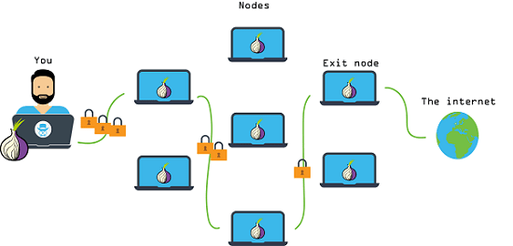
Similar dilemma: Tor
Anonymous communication network
Sender and receiver of message unlinkable
Used by:
Normal people
Journalists & activists
Law enforcement
Malware
Funded by (among others):
U.S. State Department

Slide 16
Anonymous e-cash: history
Crypto
magic
David Chaum, 1982
Blind signature: two-party protocol to create digital signature without signer knowing the input

Slide 17



Anonymous e-cash via blind signatures
User | Balance
… | …
 | 10
… | …
 | 5
Spent coins
…
Withdraw anonymous coin
{317038628684424}
9
31703862…
Deposit coin # 317038628684424
{317038628684424}
6
OK
Bank cannot link the two users

Slide 18
Anonymity & decentralization: in conflict
Interactive protocols with bank are hard to decentralize
Decentralization often achieved via public traceability to enforce security

Slide 19
How to de-anonymize Bitcoin

Slide 20
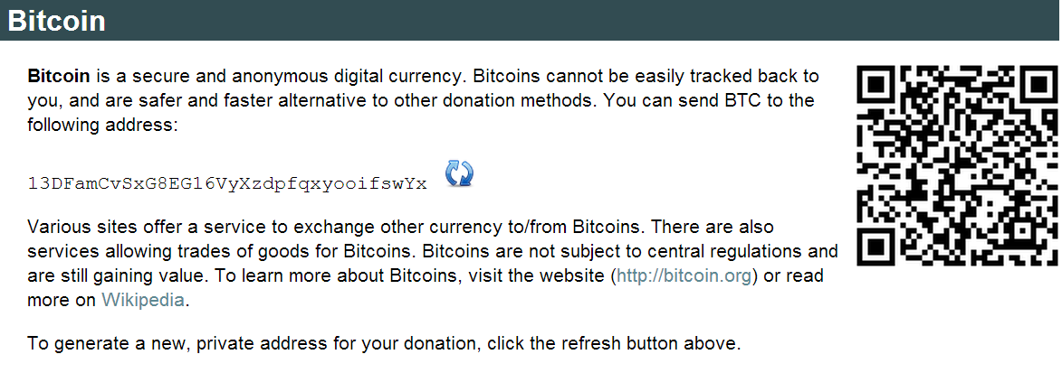

Slide 21
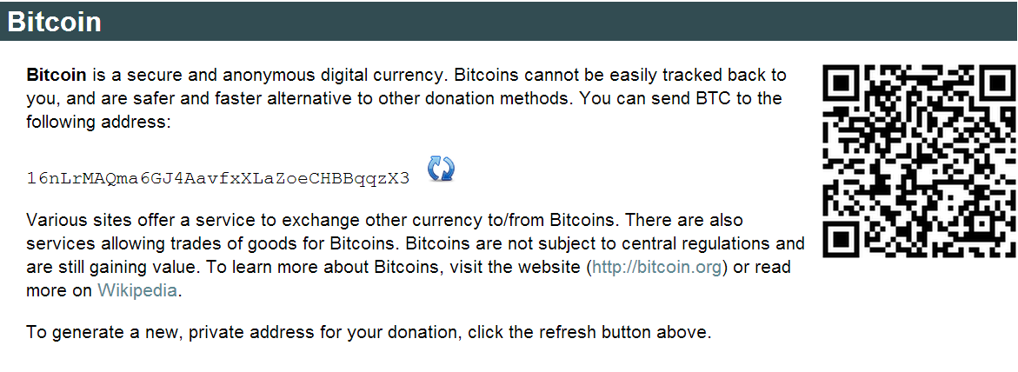

Slide 22
Trivial to create new address
Best practice: always receive at fresh address
So, unlinkable?

Slide 23

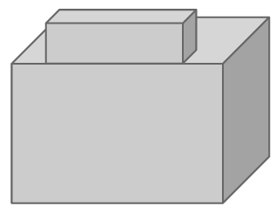

Alice buys a teapot at Big box store
5
8
3
Single
transaction
6

Slide 24
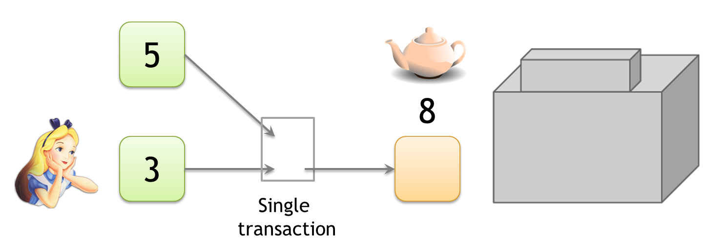
Linking addresses
Shared spending is evidence of joint control
Addresses can be linked transitively

Slide 25
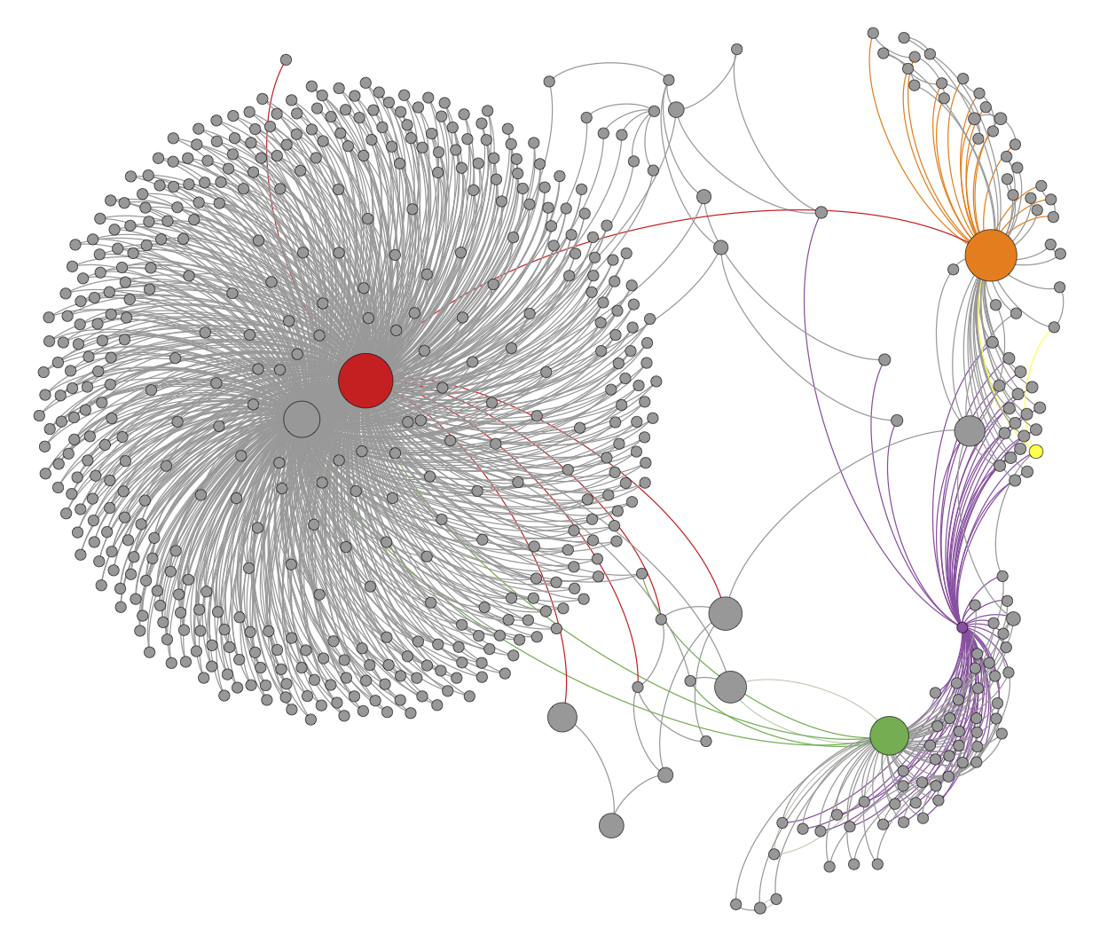
Clustering of addresses
An Analysis of Anonymity in the Bitcoin System
F. Reid and M. Harrigan
PASSAT 2011

Slide 26
Change addresses
5
8.5
3
6
.5
Which address
is change?

Slide 27
“Idioms of use”
Idiosyncratic features of wallet software
e.g., each address used only once as change
Notes:
Fragile. Requires manual tuning, false positives

Slide 28
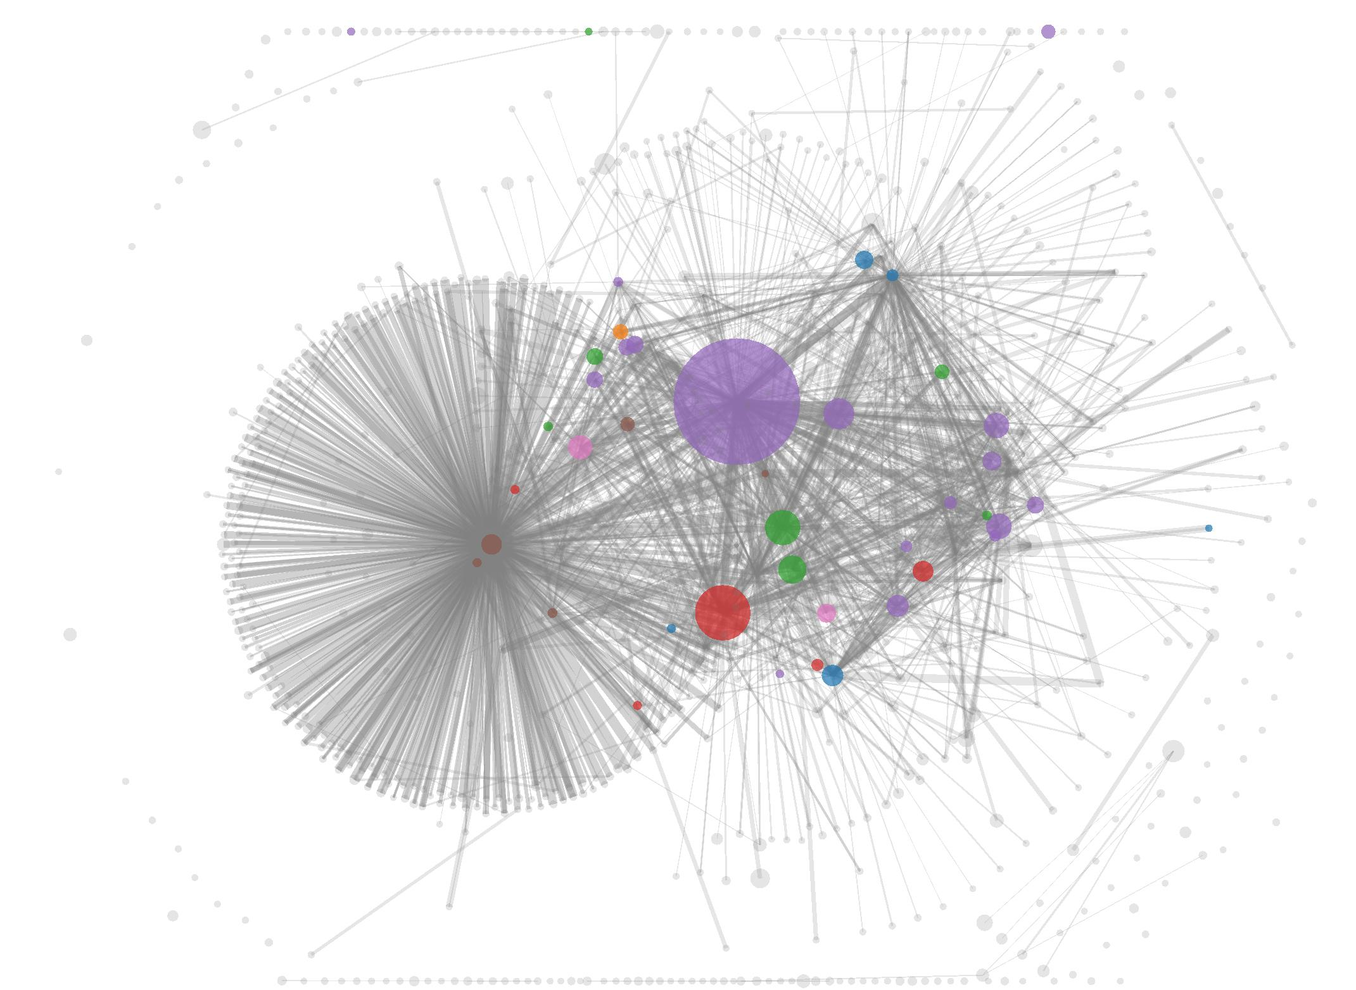
Shared spending + idioms of use
A Fistful of Bitcoins: Characterizing Payments Among Men with No Names
S. Meiklejohn et al.
IMC 2013

Slide 29
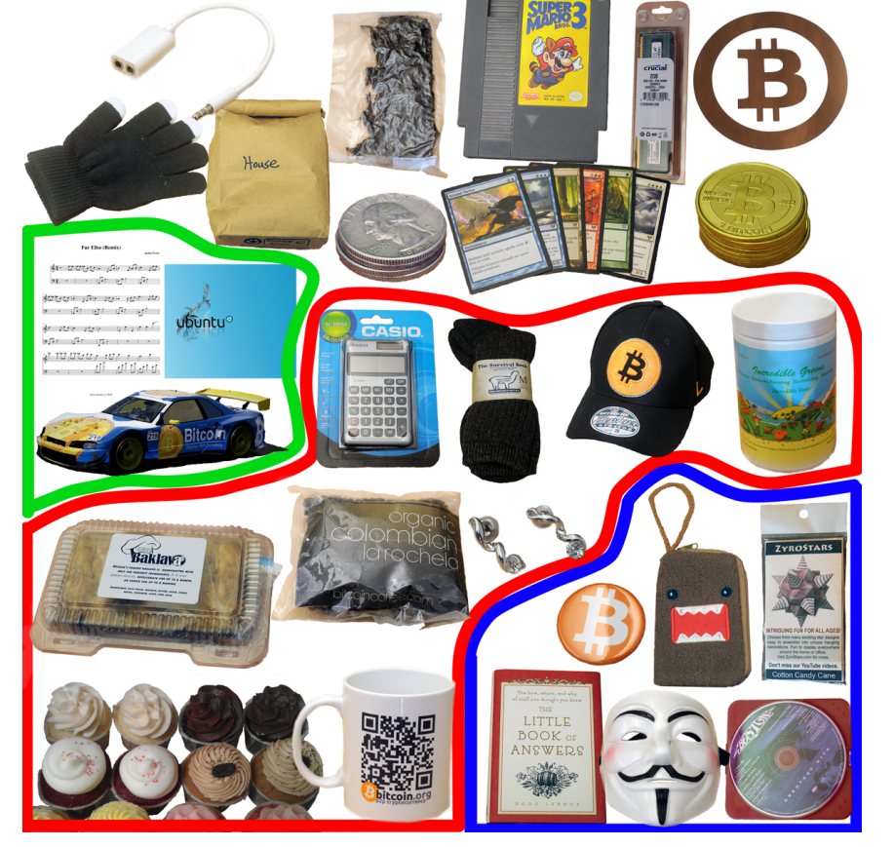
To tag service providers: transact!
A Fistful of Bitcoins: Characterizing Payments Among Men with No Names
S. Meiklejohn et al.
344 transactions
Mining pools
Wallet services
Exchanges
Vendors
Gambling sites

Slide 30
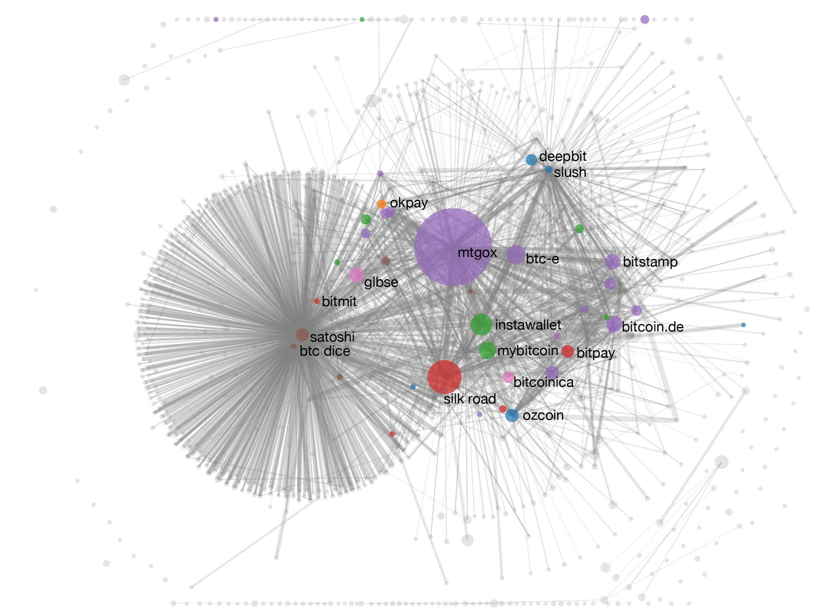
Shared spending + idioms of use
A Fistful of Bitcoins: Characterizing Payments Among Men with No Names
S. Meiklejohn et al.

Slide 31
From services to users
1. High centralization in service providers
Most flows pass through one of these — in a
traceable way
2. Address — identity links in forums

Slide 32
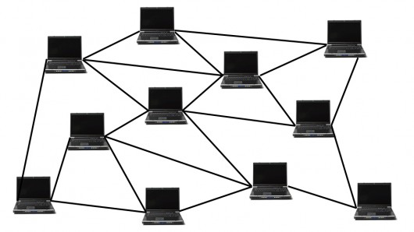

Network-layer de-anonymization
“The first node to
inform you of a
transaction is probably
the source of it”
Dan Kaminsky
Black Hat 2011 talk

Slide 33
Solution: use Tor
Caveat: Tor is intended for low-latency activities such as web browsing
Mix nets might provide better anonymity
BUT Tor is what’s deployed and works

Slide 34
Mixing

Slide 35

To protect anonymity, use an intermediary

Slide 36
To protect anonymity, use an intermediary
Online wallets do this
Do they provide anonymity?!

Slide 37
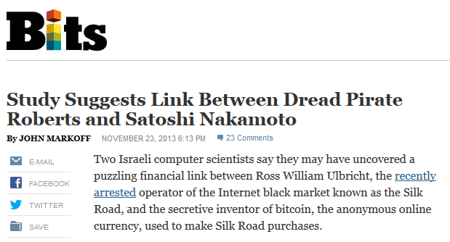

Slide 38
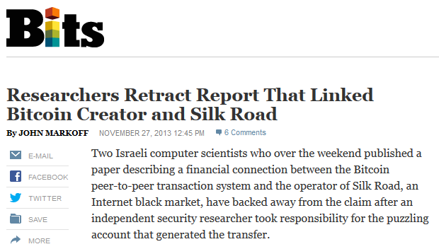

Slide 39
Dedicated mixing services
Promise not to keep records
Don’t ask for your identity

Slide 40
Back to online wallets
Reputable, often regulated, businesses
Typically require identity, keep records ➔ no anonymity w.r.t. wallet service
Users trust them with their bitcoins ➔ keep them for longer ➔ bigger anonymity set w.r.t. everyone else

Slide 41
Rest of this lecture:
assume a user for whom the trust requirements and anonymity properties of online wallets are unacceptable

Slide 42
Mixing: terminology
Mix vs. mixer
Another term: laundry
Won’t use in this lecture

Slide 43
Principles for mixing services
1. Use a series of mixes
Mixes should implement a
standard API to make this
easy
Mixcoin: Anonymity for Bitcoin with accountable mixes
J. Bonneau et al.
Financial Cryptography 2014

Slide 44
Series of mixes
Mix 1
Mix 2
Mix 3
Notes:
Generate a fresh address
Same principle behind Tor
Ideally we want all transactions to look identical, which motivates…

Slide 45
Principles for mixing services
2. Uniform transactions
In particular: all mix
transactions must have the
same value!
“Chunk size”
Mixcoin: Anonymity for Bitcoin with accountable mixes
J. Bonneau et al.
Financial Cryptography 2014

Slide 46
Principles for mixing services
3. Client side must be
automated
Desktop wallet software
Mixcoin: Anonymity for Bitcoin with accountable mixes
J. Bonneau et al.
Financial Cryptography 2014

Slide 47
Principles for mixing services
4. Fees must be all-or-nothing
Probabilistic fees:
0.1% mixing fee =
mix will swallow chunk
with 0.1% chance
Mixcoin: Anonymity for Bitcoin with accountable mixes
J. Bonneau et al.
Financial Cryptography 2014
Current mixes follow none of these principles

Slide 48
Remaining problem: trusting mixes
Stay in business, build up reputation
Users can test for themselves
Cryptographic “warranties”
Notes:
Current status: frequent reports of theft

Slide 49
Currently no reputable dedicated mix
Caution: Mixing services may themselves be operating with anonymity. As such, if the mixing output fails to be delivered or access to funds is denied there is no recourse. Use at your own discretion.
— Bitcoin Wiki
Notes:
Bootstrapping problem

Slide 50
Decentralized mixing

Slide 51
Why decentralized mixing?
No bootstrapping problem
Theft impossible
Possibly better anonymity
More philosophically aligned with Bitcoin

Slide 52
Coinjoin
Each signature is entirely separate
This is 1 mixing round
Mixing principles from before apply on top of basic protocol
Single
transaction
Proposed by Greg Maxwell, Bitcoin core developer

Slide 53
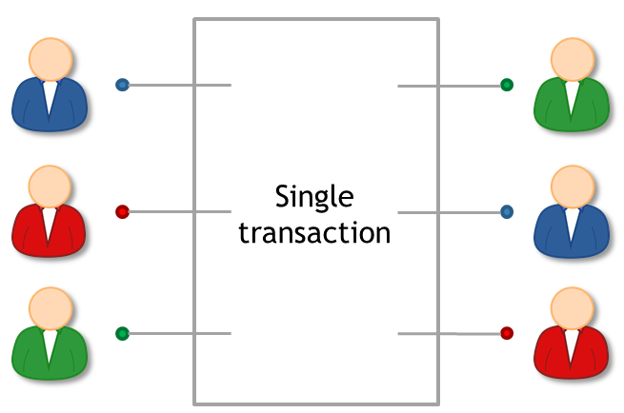
Coinjoin algorithm
Find peers who want to mix
Exchange input/output addresses
Construct transaction
Send it around, collect signatures (Before signing, each peer checks if her output is present)
Broadcast the transaction

Slide 54
Coinjoin: remaining problems
How to find peers
Peers know your input-output mapping (This is a worse problem than for centralized mixes)
Denial of service

Slide 55
Finding peers
Use an untrusted server

Slide 56
Peer anonymity
Strawman solution:
exchange inputs
disconnect and reconnect over Tor
exchange outputs
Better solution: special-purpose anonymous routing mechanism
Notes:
Note: not necessary to communicate outputs securely

Slide 57
Denial of service
Proposed solutions:
Proof of work
Proof of burn
Server kicks out malicious participant
Cryptographic “blame” protocol (CoinShuffle: Practical Decentralized Coin Mixing for Bitcoin T. Ruffing et al., PETS 2014)

Slide 58
High-level flows could be identifying
Example:
Alice receives 43.12312 BTC / week as income Always immediately transfers 5% to retirement account

Slide 59
Heuristic: merge avoidance
Instead of a single payment transaction
receiver provides multiple output addresses
sender avoids combining different inputs
(Proposed by Mike Hearn)
Notes:
Can go a long way to improve anonymity even without mixes

Slide 60
Zerocoin and Zerocash

Slide 61
Zerocoin: protocol-level mixing
Mixing capability baked into protocol
Advantage: cryptographic guarantee of mixing
Disadvantage: not currently compatible with Bitcoin
Zerocoin: Anonymous Distributed E-Cash from Bitcoin
I. Miers et al.
IEEE S&P 2013

Slide 62
Basecoin and Zerocoin
Basecoin: Bitcoin-like Altcoin
Zerocoin: Extension of Basecoin
Basecoins can be converted into zerocoins and back
Breaks link between original and new basecoin

Slide 63
Zerocoins
A Zerocoin is a cryptographic proof that you owned a Basecoin and made it unspendable
Miners can verify these proofs
Gives you the right to redeem a new Basecoin
(Somewhat like poker chips)

Slide 64
Two challenges
How to construct these proofs?
How to make sure each proof can only be “spent” once?

Slide 65
Zero-knowledge proofs
Crypto
magic
A way to prove a statement
without revealing any other
information
Example:
“I know an input that hashes to da39a3ee5e”
“I know an input that hashes to some hash in the following set: … ”

Slide 66
Minting zerocoins
Zerocoins come in standard denominations
(Let’s assume 1 basecoin)
Anyone can make one!
They have value once put on the block chain
That costs 1 basecoin

Slide 67

Minting a zerocoin: “commitment”
Generate serial number S
(eventually made public)
and random secret r
(never public, ensures
unlinkability)
Compute H(S, r)
Serial number:
317038628684424
Simplification

Slide 68
Minting a zerocoin
To put H(S, r) on block chain
Create Mint Tx with 1 basecoin as input
signed by A
Mint
H(S, r) H( )

Slide 69
To spend a zerocoin S:
Reveal S (miners will verify S hasn’t been spent before)
Create zero-knowledge proof that: “I know a number r such that H(S, r) is one of the zerocoins in the block chain”
Pick arbitrary zerocoin in block chain & use as input to your new transaction

Slide 70

Zerocoin is anonymous
Since r is secret, no one can figure out which zerocoin corresponds to serial number S
H(S, r)
…
h₁
h₂
h_{N}

Slide 71
Zerocoin is “efficient”
The proof is a giant disjunction over all zerocoins
Yet the proof is relatively small!
I know r such that
H(S, r) = h₁
OR
H(S, r) = h₂
OR
…
OR
H(S, r) = h_{N}

Slide 72
Zerocash: Zerocoin without Basecoin
Two differences
Different crypto for proofs (More efficient)
Proposal to run system without Basecoin
Zerocash: Decentralized Anonymous Payments from Bitcoin
E. Ben-Sasson et al.
Usenix Security 2014
Notes:
Sender and recipients know amounts, but nobody else
Prove to miners in zero knowledge that input amount >= output amount
Avoids side-channel problems associated with mixing

Slide 73
Zerocash: untraceable e-cash
All transactions are zerocoins
Splitting and merging supported
Put transaction value inside the envelope
Ledger merely records existence of transactions
Notes:
Sender and recipients know amounts, but nobody else
Prove to miners in zero knowledge that input amount >= output amount
Avoids side-channel problems associated with mixing

Slide 74
Zerocash: the catch
Random, secret inputs are required to generate public parameters
These secret inputs must then be securely destroyed
No one can know them (anyone who does can break the system)
Notes:
Believability

Slide 75
5 levels of anonymity
System | Type | Anonymity attacks | Deployability
Bitcoin | Pseudonymous | Tx graph analysis | Default
Single mix | Mix | Tx graph analysis, bad mix | Usable today
Mix chain | Mix | Side channels, bad mixes/peers | Bitcoin-compatible
Zerocoin | Cryptographic mix | Side channels (possibly) | Altcoin
Zerocash | Untraceable | None | Altcoin, tricky setup
Notes:
Engineering complexity, believability

Slide 76
Tor and the Silk Road

Slide 77
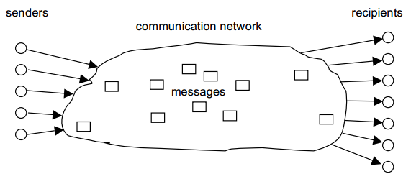
Anonymous communication

Slide 78
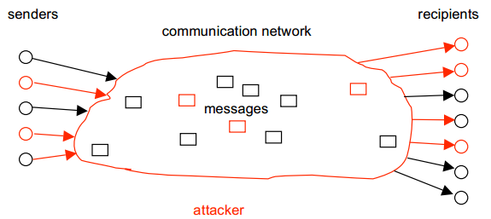
Threat model

Slide 79
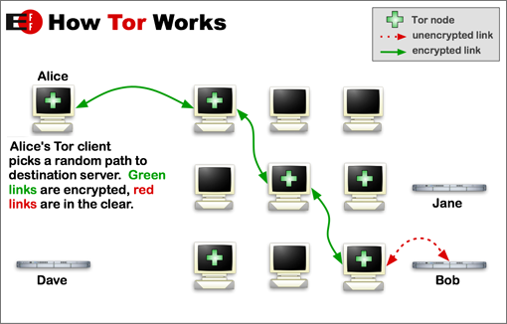
How Tor works
Safe(ish) if at least one router honest
Key challenge: hiding routing information

Slide 80
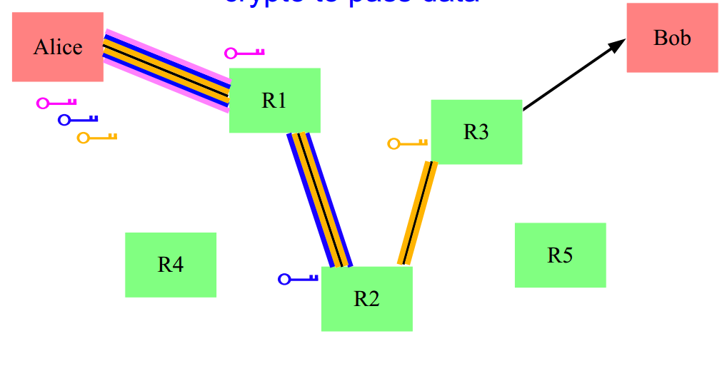
Solution: layered encryption
Side effect: contents encrypted from Alice to exit node
BUT: Unencrypted from exit node to Bob

Slide 81
Hidden services
What if the server wants to hide its address?
Simplified:
Connect to “rendezvous point” through Tor
Publish name → rendezvous point mapping
Client connects to rendezvous point
Onion address looks like http://3g2upl4pq6kufc4m.onion/

Slide 82
Silk Road
Communication: Tor hidden service
Payment: Bitcoin
Security?
Anonymous shipping?

